Slide 1
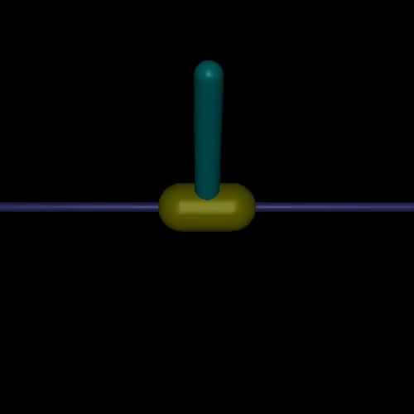
Reflexes for More Effective RL
MuJoCo environment for real-time training of QuickNet that adaptively responds to the environment
Added perturbation parameters:
Frequency: every 2-4 seconds
Duration: 20 ms
Perturbation: between (0 - x* g)
Perturbation direction: Randomly left and right
Environment parameters:
Agent Reaction speed: 40 ms*
Force: -3, 3
Episode parameters:
Maximum steps: 1000*
Reward per step: 1
Max total reward: 1000*
Algorithm parameters:
Initial timesteps to sample: 25000*
Maximum timesteps: 100000*
Update steps: 75000*
* Parameters that change with reaction speed

Slide 2
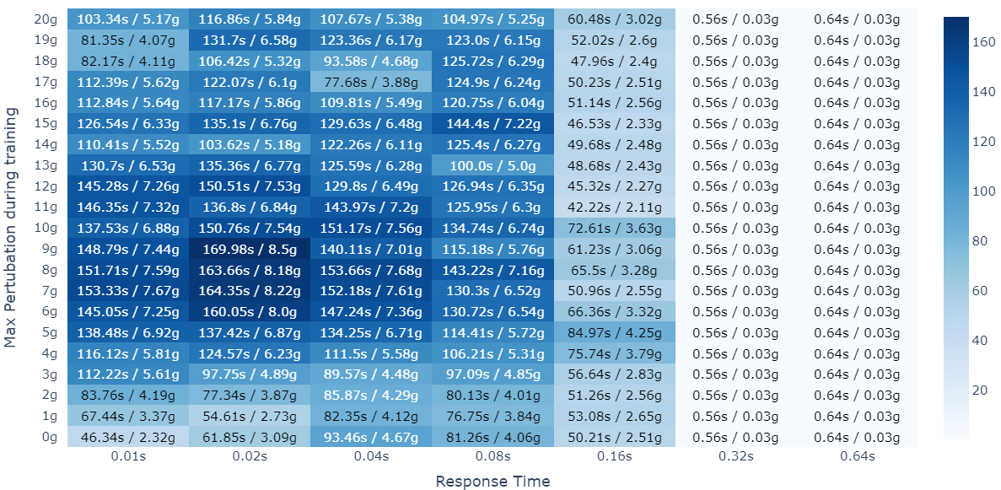
Varying response rate changes the problem difficulty
Avg. seconds in test environment / Min. Perturbation force required for failure
Test environment: The perturbation is applied every 5 seconds and is increased by 0.25g every time it is applied.
The sweet spot of response rate:
Not too fast: An agent that responds too fast will need to learn a larger number of states. Making it harder to learn.
Not too slow: An agent that is too slow to respond will fail when fast perturbation is applied
Avg. over 5 trials

Slide 3
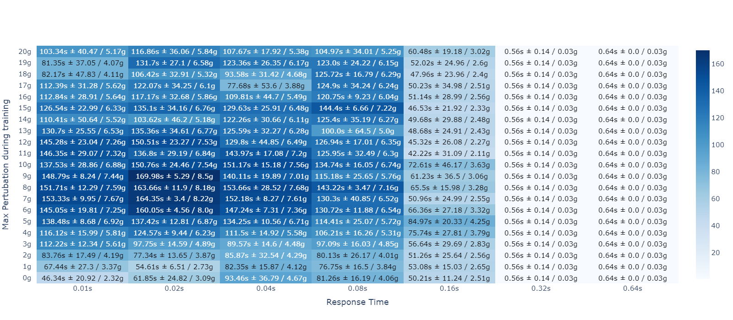
With Standard Deviation

Slide 4
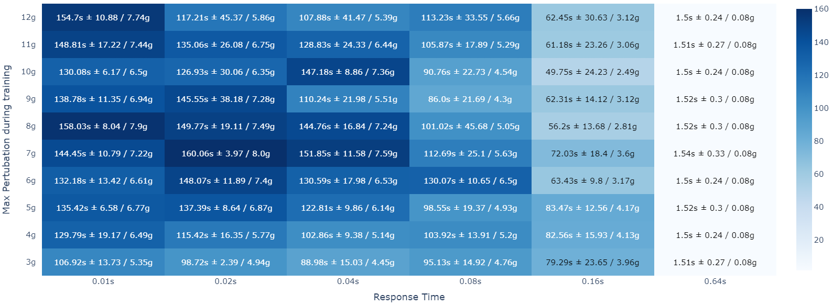
With Standard Deviation (delayed)

Slide 5
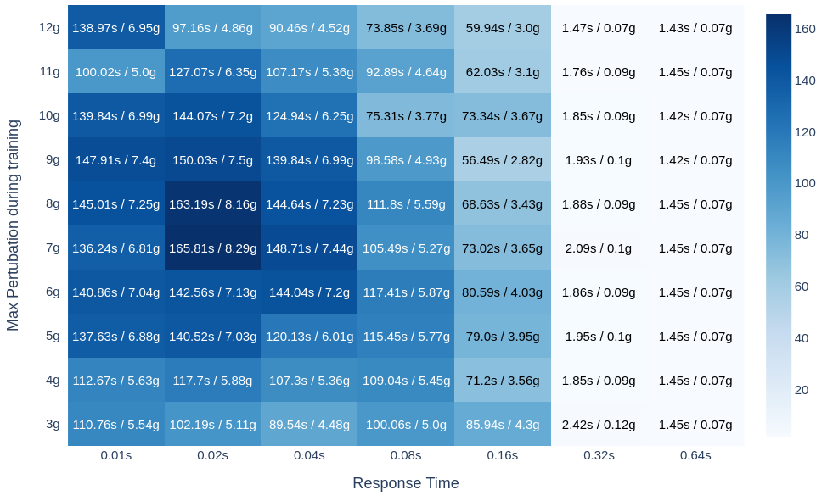
Real-time control adds further difficulty in training
In a real-time setting, the environment moves forward while the agent is processing the input, making it a harder problem.

Slide 6
Adding adaptive response improves performance
Algorithm
Process current state to get action.
If Reflex: start within 0.02 seconds and remain for 0.06 seconds
Else: start at 0.08 seconds
Network | Network | Avg. Seconds / Perturbation force | Avg. Actions / Decisions
Network 1 0.04s reaction speed | Default 0.04s | 144.64 / 7.232 | 3616.0
 | Reflex Network | 146.34 / 7.317 | 3659.14
Network 2 0.08s reaction speed | Default | 111.8 / 5.59 | 1397.5
 | Reflex Network | 122.25 / 6.112 | 1528.26
Network 3 0.16s reaction | Reflex Network | 95.3 Original: 84.97
Fast reflex (0.02s)
Action
Original network with 2 hidden layers with 256 neurons
The reflex acts at angles > 0.19. The agent fails at angle 0.2.
Reflex Networks learn a better policy.
During evaluation, reflexes are rarely activated.
3 added neurons for reflex

